Slide 1
Topics of this course
What is CS ?
Lect 1: what is computer
Lect 2: how is computer system working
Lect 3: Turing machine & P vs NP
Lect 4: computational thinking & algorithm
Lect 5: cloud computing
Why is CS so hot ?
Lect 6: introduction to machine learning and AI
Lect 7: introduction to big data
Lect 8: introduction to alphaFold/alphaFold2
How to learn CS ?

Slide 2
Introduction to big data
qiang@suda.edu.cn

Slide 3
“There are two kinds of scientific revolutions, those driven by new tools and those driven by new concepts…… The effect of a concept-driven revolution is to explain old things in new ways. The effect of a tool-driven revolution is to discover new things that have to be explained. ”
Freeman Dyson, Imagined Worlds, Harvard University Press, 1997. pp.49-50.

Slide 4
Big data is an emerging era
The way to do
Computing based
the target to deal with
Data->big data
“White horse is not horse”
Vivid examples of Big data

Slide 5
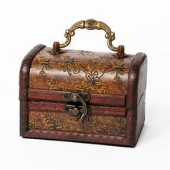
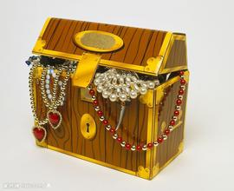
Let’s begin with a game
Only one box contains treasure

Slide 6
Make a bet by you:

Slide 7
God eliminates one empty

Slide 8
Change your selection if allowed?
？

Slide 9
Mathematical analysis
The first bet chance：1/3

Slide 10
Change the bet:
2/3

Slide 11
Argue: why not ½？
½？
Coz it is not a completely new bet!

Slide 12
Another totally different solution：computational approach
？

Slide 13
An intuitive computational solution
for (i=0; i<counter; i++) {
treasure = random() % 3; /* put the treasure */
choice = random() % 3; /* make a guess */
eliminate = 0;
while (eliminate==treasure || eliminate==choice)
eliminate++;
change = 0;
while (change==choice || change==eliminate)
change++;
if (choice==treasure) wins++;
if (change==treasure) changeWins++;
} printf(“change odds=%f”, changeWins/counter);
2/3

Slide 14
Why the solution is correct?
Because the modeled problem = target problem
Because the computation solves perfectly the modeled problem

Slide 15
How we solve real world problems
A real world problem
modeling
Math-oriented
Modeled problem
Comp-oriented
Solving
techs
????-oriented

Slide 16
We usually lost infor when modeling
A real world problem
Solving out the modeled problem
does not mean
Solving out the real world problem.
modeling
Modeled problem
Solving
techs
solvable-oriented

Slide 17
Revise that computational solution
for (i=0; i<counter; i++) {
treasure = random() % 3; /* put the treasure */
choice = random() % 3; /* make a guess */
eliminate = 0;
while (eliminate==treasure || eliminate==choice)
eliminate++;
change = 0;
while (change==choice || change==eliminate)
change++;
if (choice==treasure) wins++;
if (change==treasure) changeWins++;
} printf(“change odds=%f”, changeWins/counter);
Is this a math way?
Is this an experimental way?
This is a computational way?

Slide 18
2 major paradigms to do science
Theory (logical reasoning)
Experiment
The 3rd: Computing? Yes, I believe!

Slide 19
Big data is an emerging era
The way to do
Computing based
The target to deal with
Data->big data
“White horse is not horse”
Vivid examples of Big data

Slide 20
What is data?
Symbol representations of real world objects.
A real world problem
Real world objects
modeling
Modeled problem
Data
Solving
techs

Slide 21
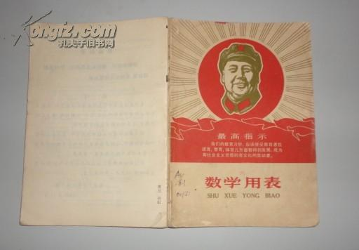
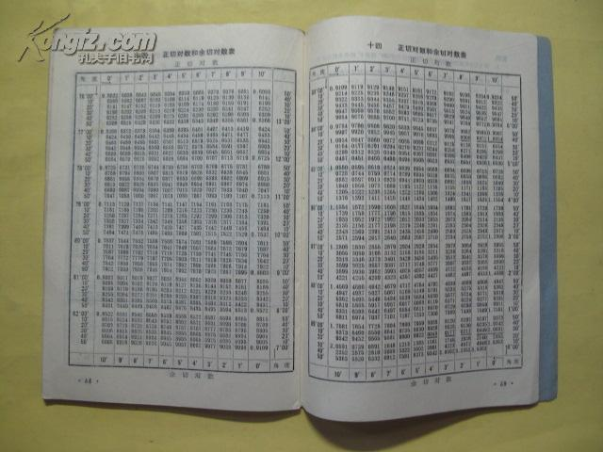
Data for computational way
Do we care what is sin(x)?
No, if data is there!
and if it tells sin(x)!
Not even you don’t know f(x),
but data is there!

Slide 22
Remember that s24 game?
List all available correct instances
So-called algorithm is just to look up a dictionary
Data is algorithm itself ?!
But, is data enough??

Slide 23
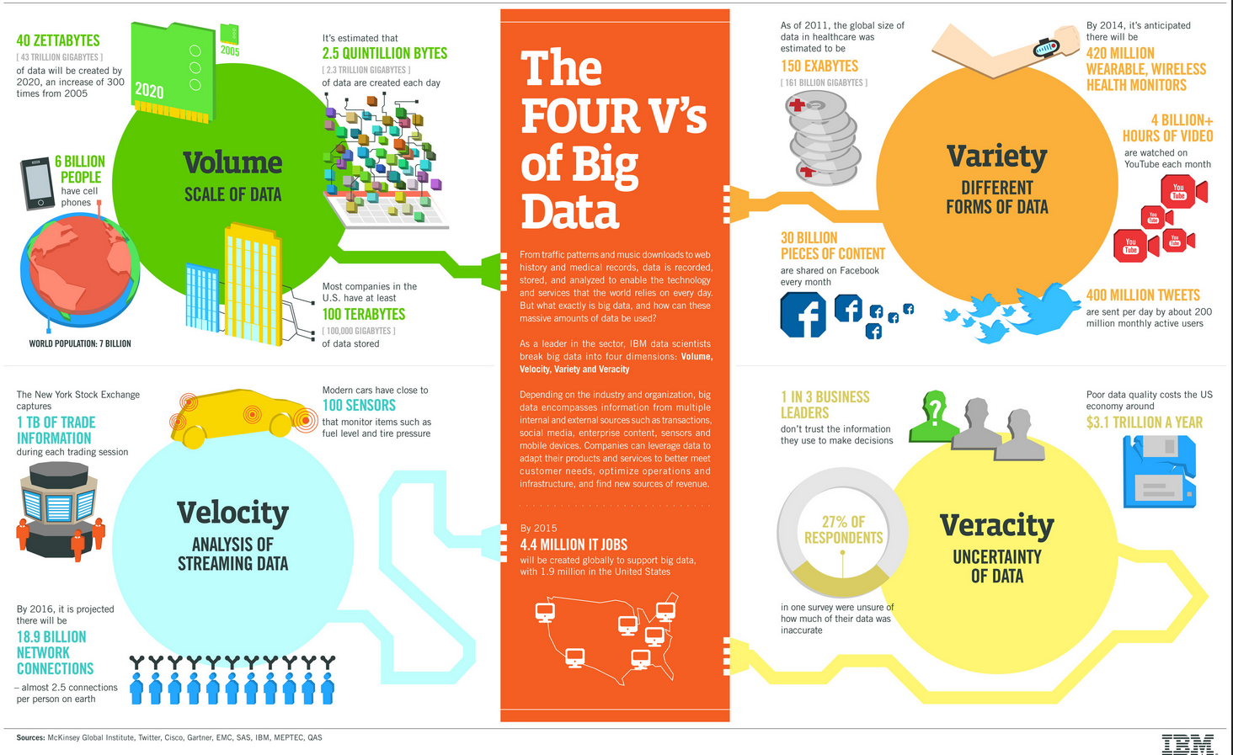
What is big data: 4v model

Slide 24
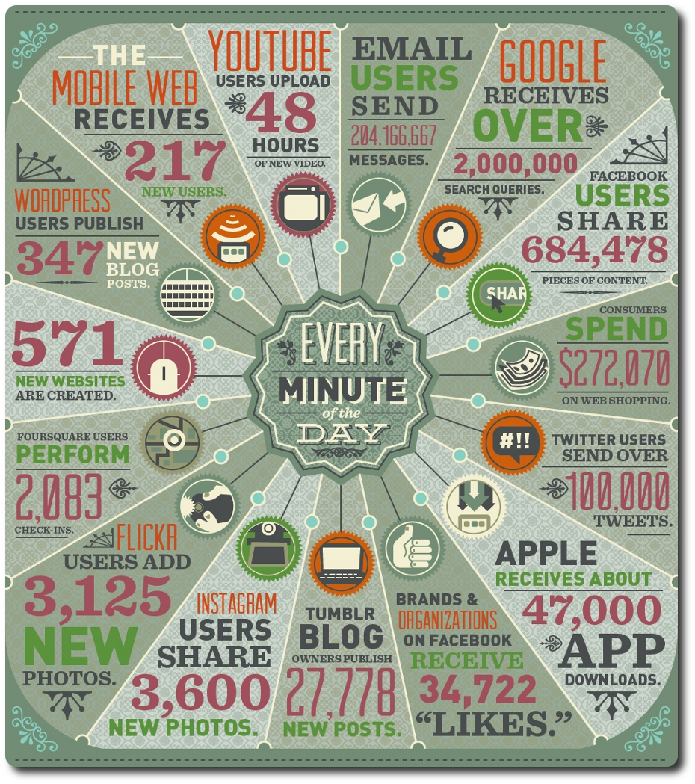
Let’s see a real world:

Slide 25
Big data: big for what?
Big is not absolute in fixed scale.
Big is for comparatively speaking:
For small
For not big
Beyond the processing capacities of regular computers
“Big data is not data?”
“Quantitative change results in qualitative change.” But where is the tipping point?

Slide 26
Big data, a misused hot word
“你们平均体重比他们多增加了350克，每年多走了13.1万步，少上了4节课，多读了1.7本书，少追了0.7部剧，多换了0.1部手机，视力少下降了1.4度。你们多谈了0.13次恋爱，少失恋了0.05次，单身比例降低了3.3个百分点。……你们平均主动表白0.5次，成功0.3次，这60%的成功率似乎告诉我们苏大有真情，表白需趁早，此情犹可待，今日正当时……”
熊思东校长在讲话中风趣地将今年毕业生的大数据分析与去年做了对比，让现场气氛顿时沸腾起来。----2017毕业典礼

Slide 27

Big data, a misused hot word(1)

Slide 28
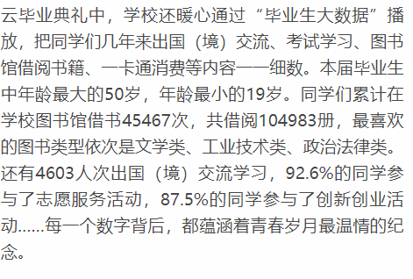
Big data: a misused hot word(2)
-----2019苏大毕业典礼

Slide 29
Misunderstandings about big data
100TB以上属于大数据
大数据需更换基础设施
80%数据是非结构化
工具将取代数据科学家
海量数据解决质量问题
实时只是速度更快而已
数据量优于专业知识
数据模型没有用

Slide 30
Big data is what a single computer cannot deal with: an example
1TB records in 10 disks
Average on a feature of records:
Scan 1TB records in one computer: 10 days
100-computer with each scanning 10GB, 2.x hours
Variance of the above feature
Require new algorithm to scan the records in less than 2 passes
New tasks for statistics and computer science

Slide 31
MapReduce: an example processing framework for big data
Mapper
Working nodes for subtasks
Reducer
Collecting results of mapper to construct final result for the target task

Slide 32
MapReduce solution example
1TB records in 10 disks
Average on a feature of records:
Scan 1TB records in one computer: 10 days
100-computer with each scanning 10GB, 2.x hours
100 Mappers, 1 Reducer
Variance of the above feature
Var(x) = E(x^2) – E(x)^2
100 Mappers: do 2 subtasks

Slide 33

Networked computers: a huge virtual “computer”

Slide 34
Challenges for big data
Volume -> distributed storage/CPU
Variety -> new data modeling techs
Velocity -> new algorithms
Veracity -> new modeling techs

Slide 35
Chances for big data
Any words will not be too bigger for describing the chances.
Basically it is tool-driven revolution. However,
Application-oriented! Instead of processing-oriented.
Just imagine!

Slide 36
Big data is an emerging era
The way to do
Computing based
The target to deal with
Data->big data
“White horse is not horse”
Vivid examples of Big data

Slide 37
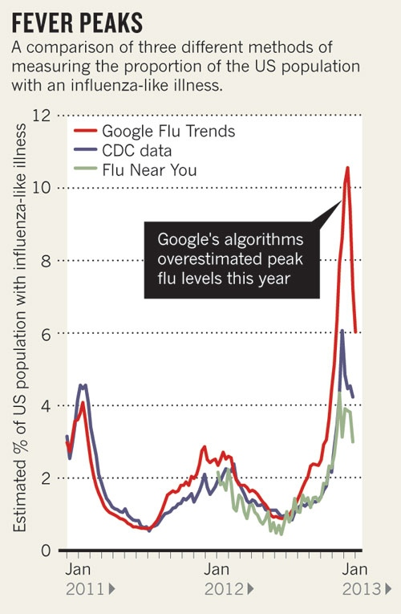
Declan Butler, When Google got flu wrong Nature 494, 155–156 (14 February 2013) doi:10.1038/494155a

Slide 38
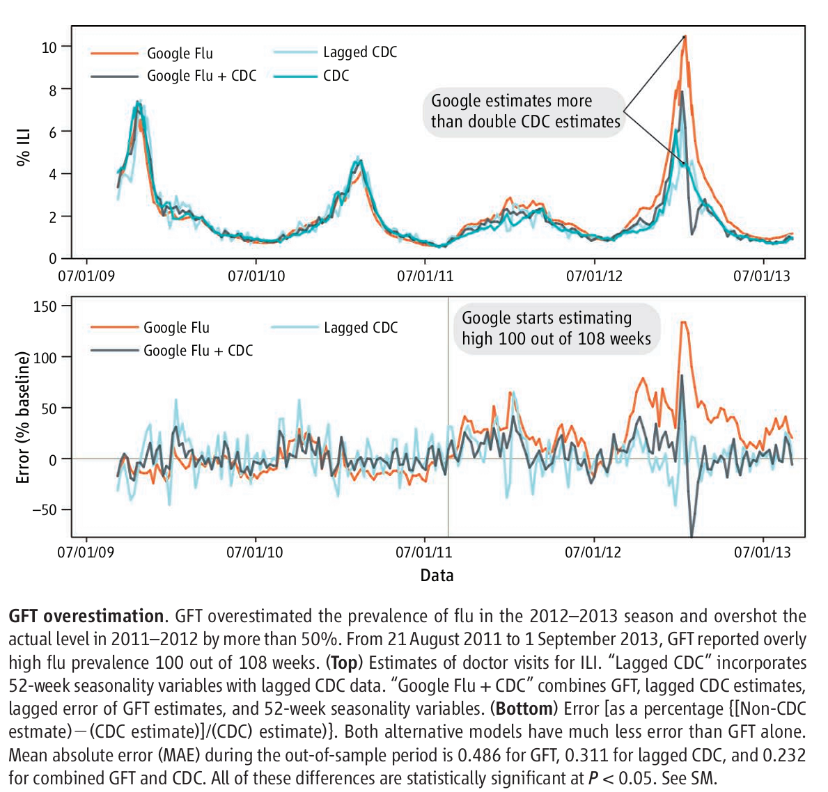
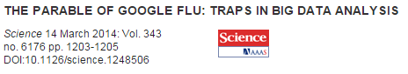

Slide 39
Reasons why GFT fails
Big data hubris
Algorithm dynamics

Slide 40
Lessons learned from GFT
Transparency and replicability
Understand the unknown
Study the algorithm
Not just about the size of the data

Slide 41
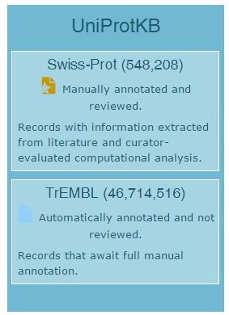
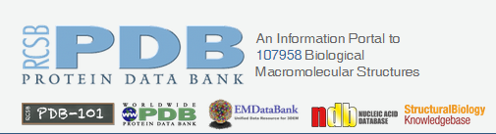
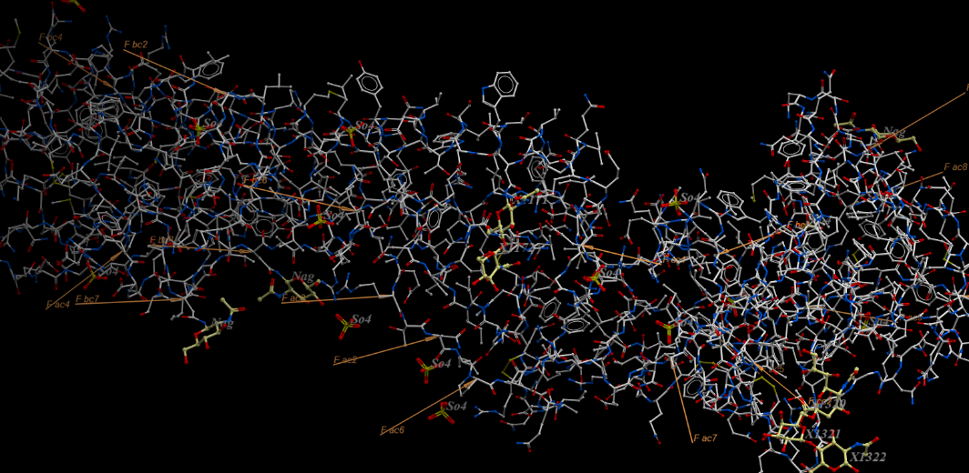
Big data of proteins
Volume
Variety
Veracity
Velocity
One structure of H7N9 proteins

Slide 42
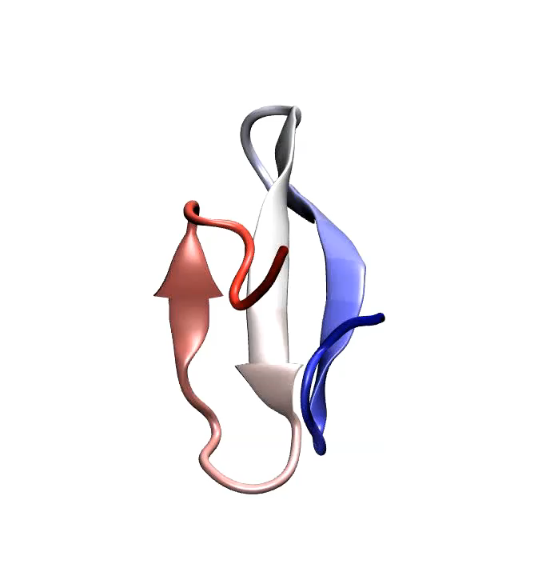
How residue chain folds into 3D structure

Slide 43
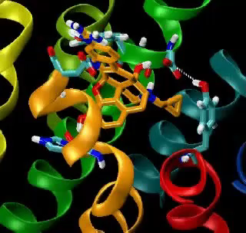
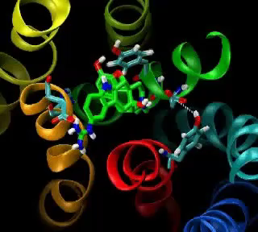
Exploring why Opioid works

Slide 44
How to deal with veracity?
Probability
Random process
Computational way: interactive parallel threads?

Slide 45
A framework to deal with PSP

Slide 46

Big data: too big to fail
It depends how you interpret and manipulate
“…So it’s like having billions of monkeys typing. One of them will write Shakespeare.”
That’s why data science is needed: to find that lucky monkey.

Slide 47
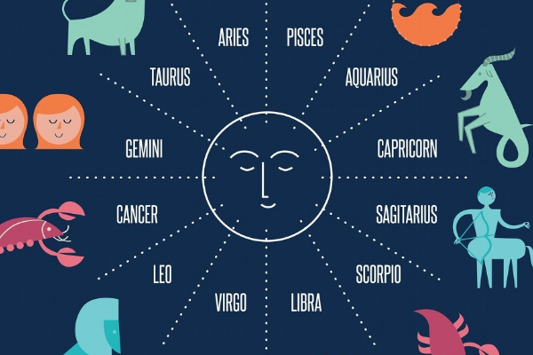
Homework 7
提出一个改进星座系统的问题和解决方案：
假定对于全球40+亿按生日排序的用户，收集到对应的1000+个生物、心理、性格等特征
定义问题：为每个星座划分起止日期；满足最佳划分准则（比如：
每个星座内的人的特征尽量相似，且不同星座内的人尽量不相似。
Or 定义你自己的最佳划分准则）
解决方案：基于上述数据集，如何求出你这个星座系统的时间划分。

